Slide 1



PharmaTrace
Securing Pharmaceutical Supply Chain Using IoT
A smart, secure, and transparent solution for drug traceability using IoT.

Slide 2
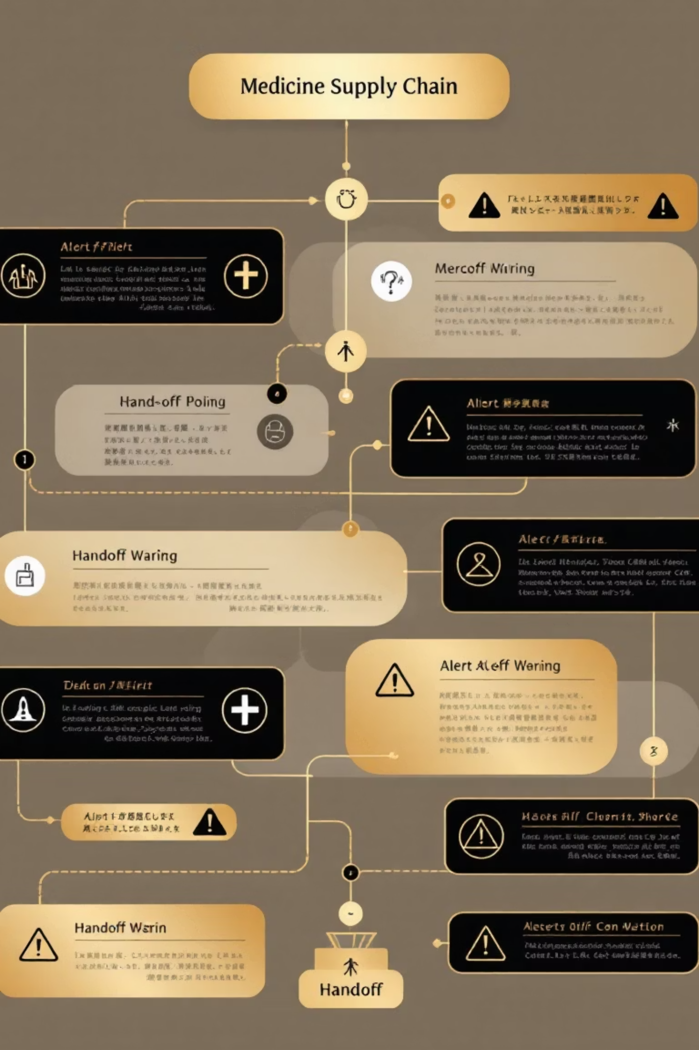
The Problem
Drugs pass through many hands: Supplier → Manufacturer → Distributor → Pharmacy → Patient.
Major issues:
❌ Fake or counterfeit drugs
⚠️ Data tampering in transit
🕵️ Lack of full traceability

Slide 3

The Idea – PharmaChain
Combine IoT + Blockchain + Cloud (Firebase) to make the system secure and transparent.
IoT (ESP32)
Tracks real-time temperature, humidity, and movement.
Firebase
Stores live sensor data in the cloud.
Web Application
Displays the real-time data visually.
Blockchain
Ensures data integrity and traceability.

Slide 4
Objectives
Track the complete journey of each medicine digitally
Monitor real-time temperature and humidity
Use Firebase for live data storage and visualization
Implement alerts for unsafe conditions
Display the data through a web dashboard
Add automation via smart contracts for approvals

Slide 5


Workflow
Supply Chain Journey: Supplier → Manufacturer → FDA → Distributor → Pharmacy → Patient
01
02
03
IoT sensors (ESP32) collect temperature and humidity
Data sent to Firebase Realtime Database
Web app reads data from Firebase and updates in real time
04
05
Alerts trigger when temperature or humidity go beyond safe limits
FDA and end users can monitor the entire process

Slide 6

System Architecture
A simple layered architecture showing how data flows through the system:
IoT Sensor
Web Dashboard
ESP32 sends real-time readings
Displays live charts and alerts
Stakeholders
Realtime DB
FDA / Manufacturer / Pharmacy / Patient
Stores and syncs sensor data

Slide 7
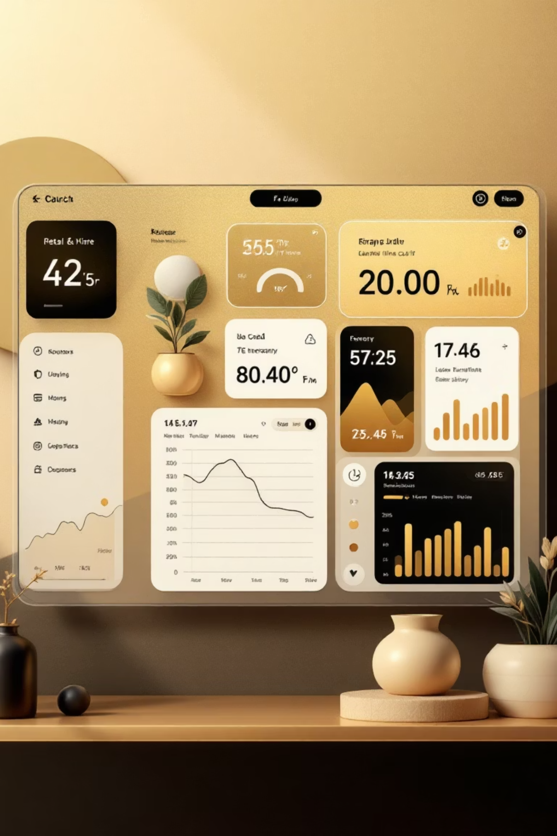
Web Application Dashboard
Built with HTML + JavaScript + Firebase SDK
Modern, responsive interface
Real-time Updates
Automatically updates using onValue() listener
Display Features
Real-time temperature and humidity with modern cards and icons
Future Upgrades
Add Chart.js graphs for trends and alert colors (green/yellow/red)

Slide 8








Results & Alerts
Real-time Updates
Alert Triggers
Data updates in real time on dashboard
If temperature >30°C or humidity >70%, alert is triggered
Reliable Performance
Safe Transport
Reliable performance with Firebase sync
Ensures safe medicine transport and monitoring

Slide 9
THANK YOU

